Slide 1
Category C - Sockets
Xavier Geerinck
Joey Comhaire

Slide 2
Sockets
Point in Inter-process Communication (IPC) (with TCP/IP)
Socket API ➔ complete collection of methods
Interaction between client and server
Made out of IP-address and port
148.39.84.21 : 3443
IP of the host Port

Slide 3
Client - Server
Client = Sends the Request to Server
Request = packets
Server = Listens to to incoming packets
Reverse Sockets = able to accept incoming connections and send requests

Slide 4
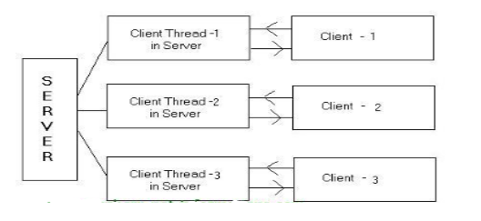
Multi-Threaded Sockets
Multiple connections
Used on servers = 1 server connects with multiple clients

Slide 5
Internet Protocols
TCP/IP
Transmission control protocol
Connection oriented
communication between clients
UDP
User Datagram Protocol
Not Connection Oriented
Validity of packets are not checked
UPNP
Universal Plug and Play
Collection of protocols
Used to forward ports

Slide 6
Port Forwarding
Sending packet over a certain network port
Firewalls have to allow the connections

Slide 7
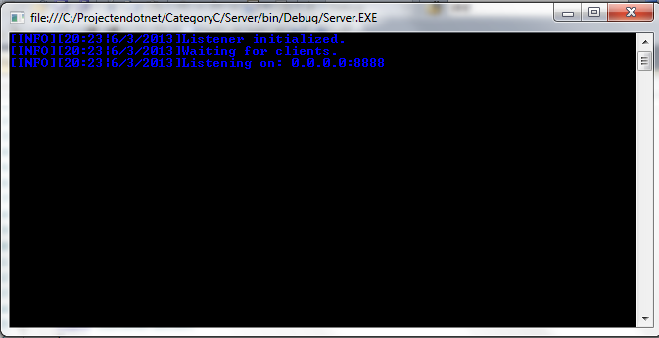
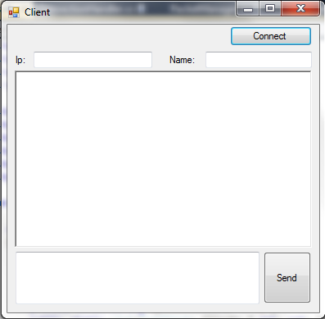
Tutorial
To connect with the right ip address of the server

Slide 8
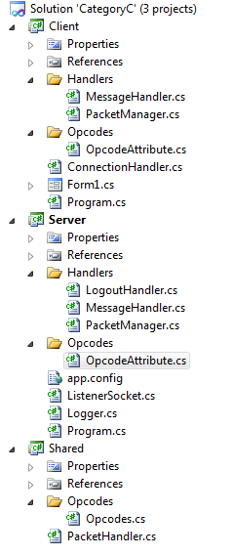
Tutorial
Application to show the
Use of sockets. 2 Clients
Will connect with a server –
Socket and send messages
Over this server.
3 Projects:
Client
Server
Shared

Slide 9
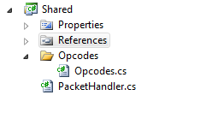
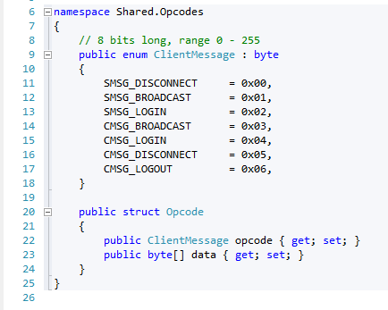
Tutorial - Shared
Opcodes
Operation Code
Used on Serverside and clientside
Defines the action that needs to be excecuted

Slide 10
Tutorial – shared
PacketHandler
1 method: SendPacket
Using System.Net.Sockets;
Parameters
Client
Message
Tasks:
Create the sending message (opcolde + message)
Send through the client stream
Delivers Classes as TCPclient
and IPAddress

Slide 11
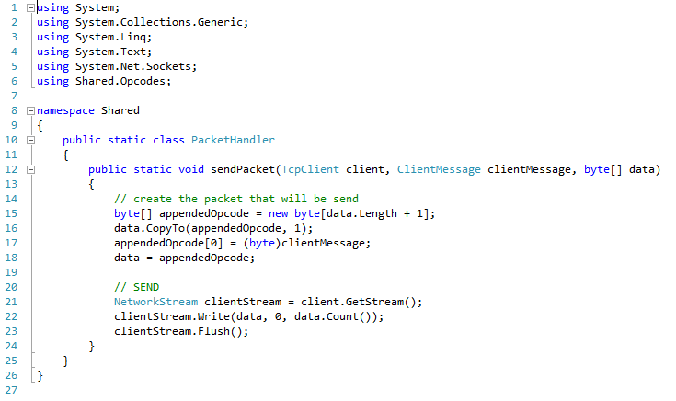
tutorial

Slide 12
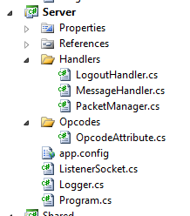
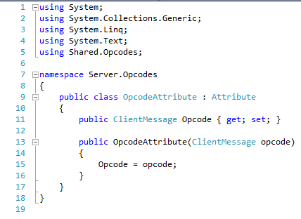
Tutorial - Server
OpcodeAttribute
Annotation of Opcodes
Using Shared.Opcodes

Slide 13
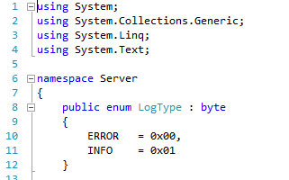
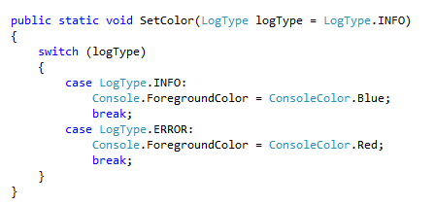
Tutorial - Server
Logger
Shows messages on the server in a certain format

Slide 14
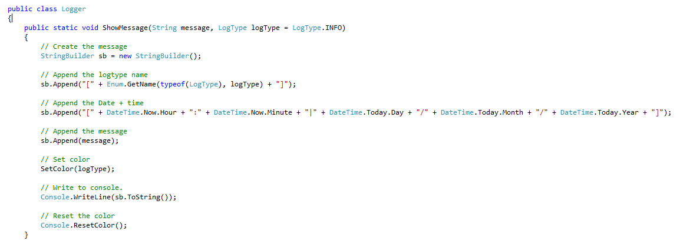
Tutorial - Server

Slide 15
Tutorial - Server
Handlers
LogoutHandler
MessageHandler
PacketManager
All these handlers use the same namespaces (look at logoutHandler)

Slide 16
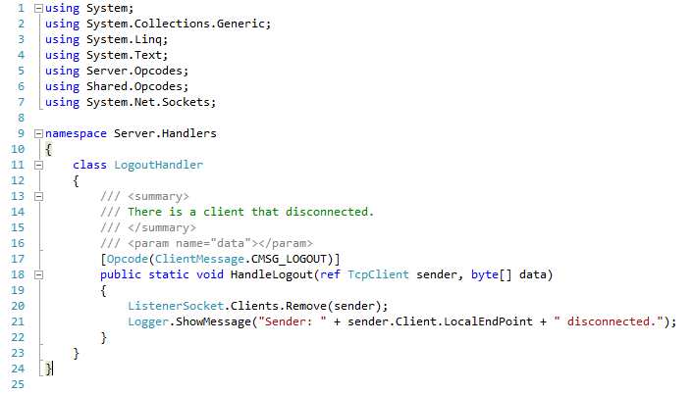
Tutorial - Server
LogoutHandler
Handles the disconnection of a client
Removes the client from the socket
Opcode

Slide 17
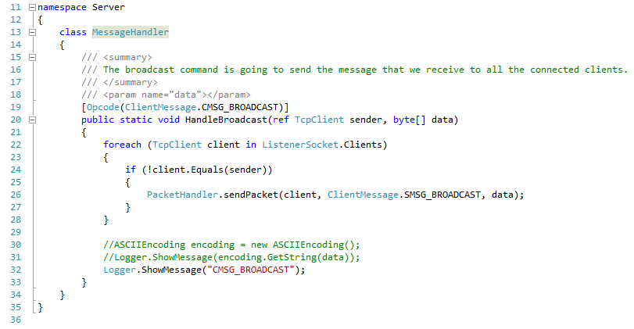
Tutorial - Server
MessageHandler
Gets the message from the client
Sends it to the packageHandler (Shared)
Opcode

Slide 18
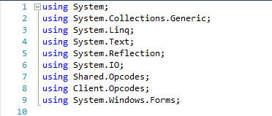
Tutorial - Server
PacketManager
Defines the handlers for the opcodes
Puts them in a dictionary together with the message
Also invokes the correct handler for the right message

Slide 19
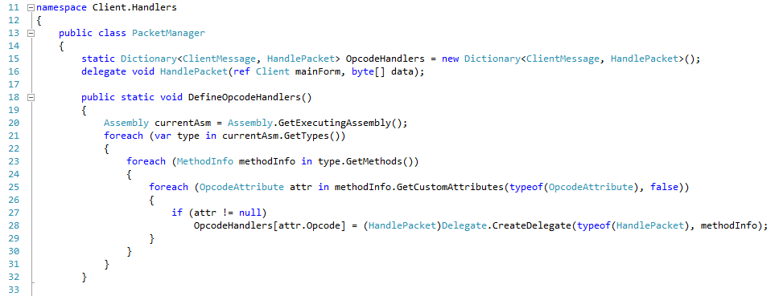
Tutorial - Server

Slide 20
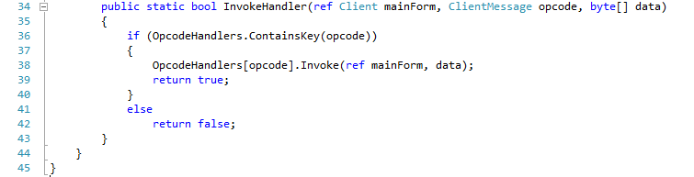
Tutorial - Server

Slide 21
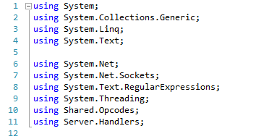
Tutorial - Server
ListenerSocket.cs
Handles the connections with each of the clients
Connects the client with a certain port of the server
Waits for incoming threads (messages) from all the clients

Slide 22
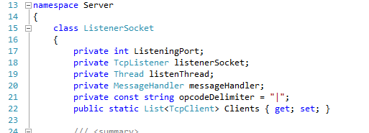
Tutorial - Server
ListenerSocket.cs - Fields
Port
The socket who listens
A listening Thread
A MessageHandler
A delimeter (constant) ➔ where to split the incoming data
List of clients

Slide 23
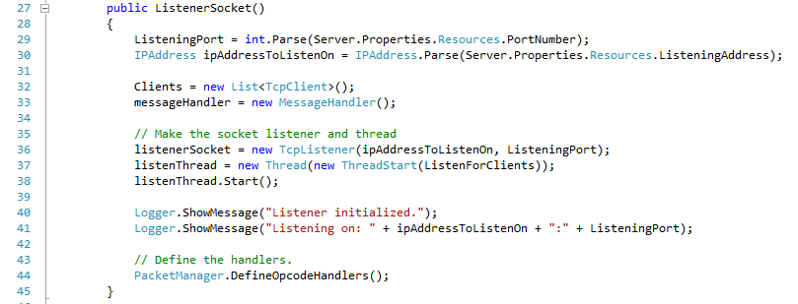
Tutorial - Server
ListenerSocket.cs – constructor
Initializes all the fields

Slide 24
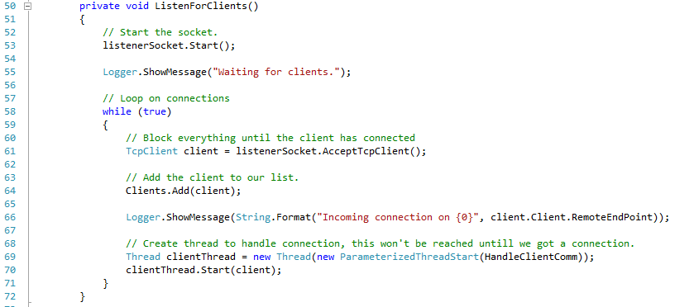
Tutorial - Server
ListenerSocket.cs – ListenForClients()
Starts the socket
Accepts incoming connections of clients
Starts new thread for every clients

Slide 25
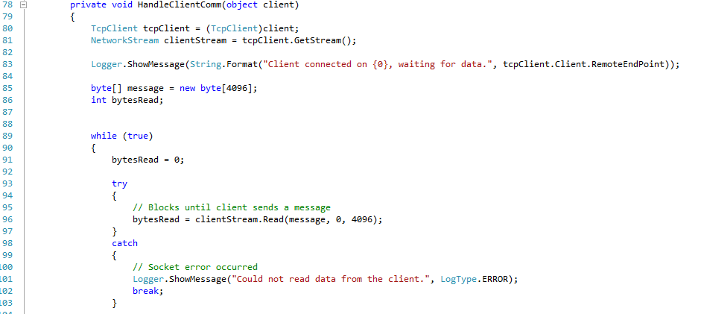
ListenerSocket.cs – HandleClientComm()
Handles the communication with the client
Sends message to other client(s)

Slide 26
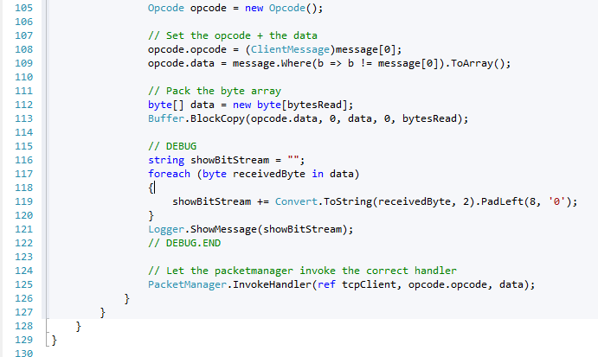

Slide 27
Tutorial - Client
Form

Slide 28
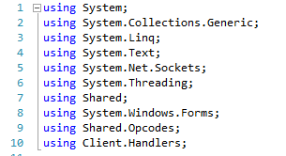

Tutorial - Client
ConnectionHandler.cs
Handles the socket where the server is connected with

Slide 29
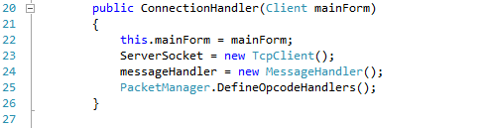
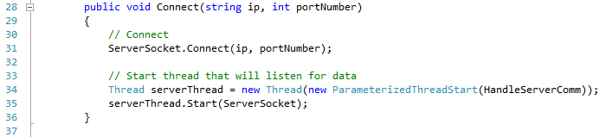
Tutorial - Client
ConnectionHandler.cs – Constructor
ConnectionHandler.cs – Connect()
Using System.Net.Sockets

Slide 30
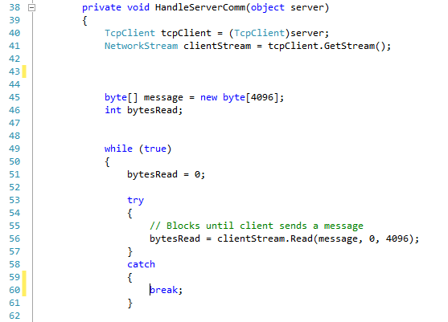
Tutorial - Client
ConectionHandler.cs – HandleServerComm()
Analogical with HandleClientComm

Slide 31
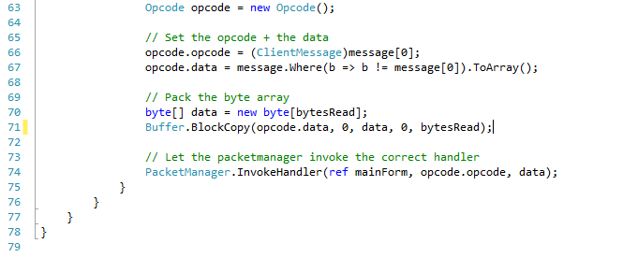
Tutorial - Client

Slide 32
Tutorial - Client
OpcodeAttribute.cs
Same as Server.OpcodeAttribute
Handlers
MessageHandler
PacketManager (analogical with Server.PacketManager)

Slide 33
Tutorial - Client
MessageHandler.cs
Used to convert the incoming message in the right format
Show the text in the form
Server sends the incoming message to all the other connected clients

Slide 34
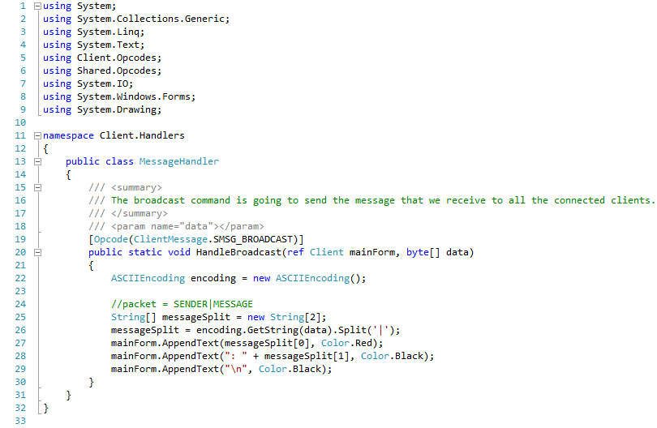
Tutorial - Client

Slide 35
Conclusion

Slide 36
Conclusion
Sockets are connections where applications or external hardware can connect to
These sockets use several protocols to maintain the protection of the connection.
To make a application that uses the subject of sockets was a difficult task

Slide 37
Sources

Slide 38
Sources
http://msdn.microsoft.com/en-US/
http://nl.wikipedia.org/wiki/Socket

